Slide 1

Mini Project on face Detection
By Gaurav Pundir
Mentor :- Mr Saurabh Mishra

Slide 2
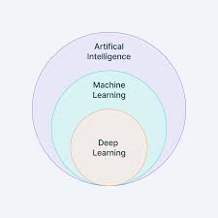
Introduction
The goal of this project is to detect and locate human face in image or video using opencv ,cnn and deep learning
Face detection is common practice used world wide with a combination of task as per use . it is made easy with the introduction of AI and Machine learning . In this project we have used a single ‘Triplet ’ training model to train our project in both image and video reorganization.

Slide 3

Problem Statement
To detect human face and be sure , it matches facial features
To display the percentage of facial expression matched

Slide 4
Methodology
Install Numpy Libary
Install Imutils Library
Install Open CV

Slide 5
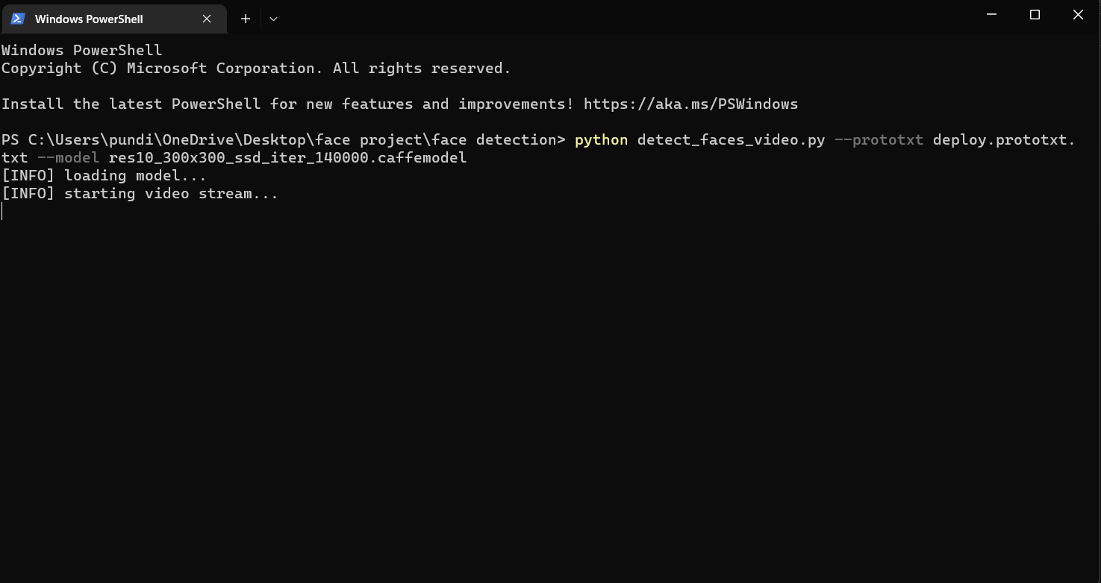
Run The code using command – prompt and given command

Slide 6
Conclusion and Future Work
This technology can be used in mask detection
Attendance System
Criminal Login and Searching

